Slide 1

Article Recommendation System
University of Toronto 3760 Term Project | April 2022
Adon/Steven

Slide 2
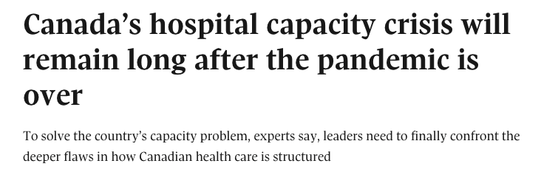
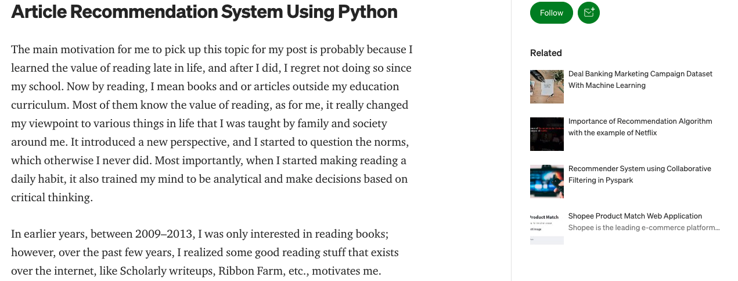
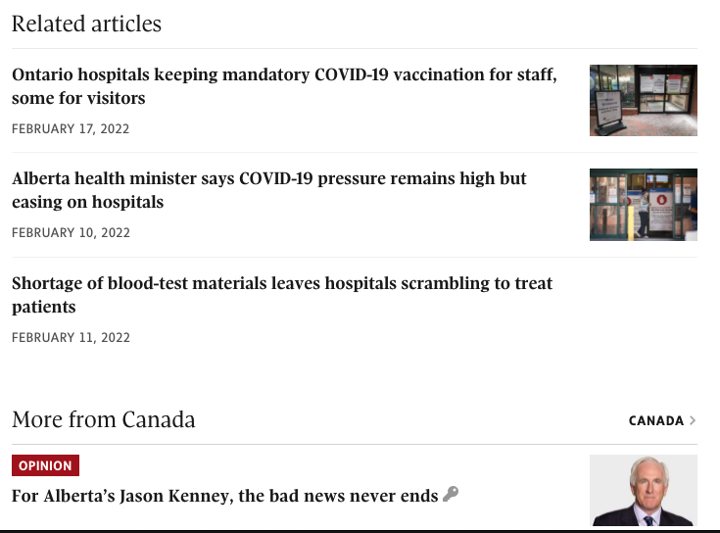

Business Case
Build an article recommendation system that EVERY publisher can use

Slide 3
Why publisher need it?
Help viewers to find desired articles quickly
Better customer satisfaction
Increase viewer engagement
Higher impression/ads revenue
More subscribers

Slide 4
Revenue and Cost analysis
Recommendation System Revenue:
Assumptions:
Publisher gets 1M page views and 10M impressions on monthly basis
Subscriber conversion 0.002% per page views
RPM (Revenue Per thousand Impressions) is $10
LTV (Lifetime Value) per subs $400
 | Average Case | Best Case
% of User Clicks Recommended article | 5% | 10%
Extra Impressions | 500,000 | 1,000,000
Extra RPM($) | $5,000 | $10,000
Extra Subscribers | 1 | 2
Extra Subs Revenue | $400 | $800
Total Extra Revenue | $5,400 | $10,800

Slide 5
Why Cloud service?
Most of publishers have already moved to online and they are already using website analytic tool (eg. Google analytic) to collect data
# of pageviews are unpredictable and it keeps changing over time, # of inference from ML model need scale up/down depending on pageviews
Highly sensitive data can be encrypted and protected by VPN
The same recommender system be replicated to a new publisher quickly

Slide 6
Solution Architecture Overview
Web scraper custom script
Dump in Bucket
BigQuery from bucket
Re-train model + pickle, save in bucket
Unpickle and provide inference via HTTP request
(low resolution summary)

Slide 7
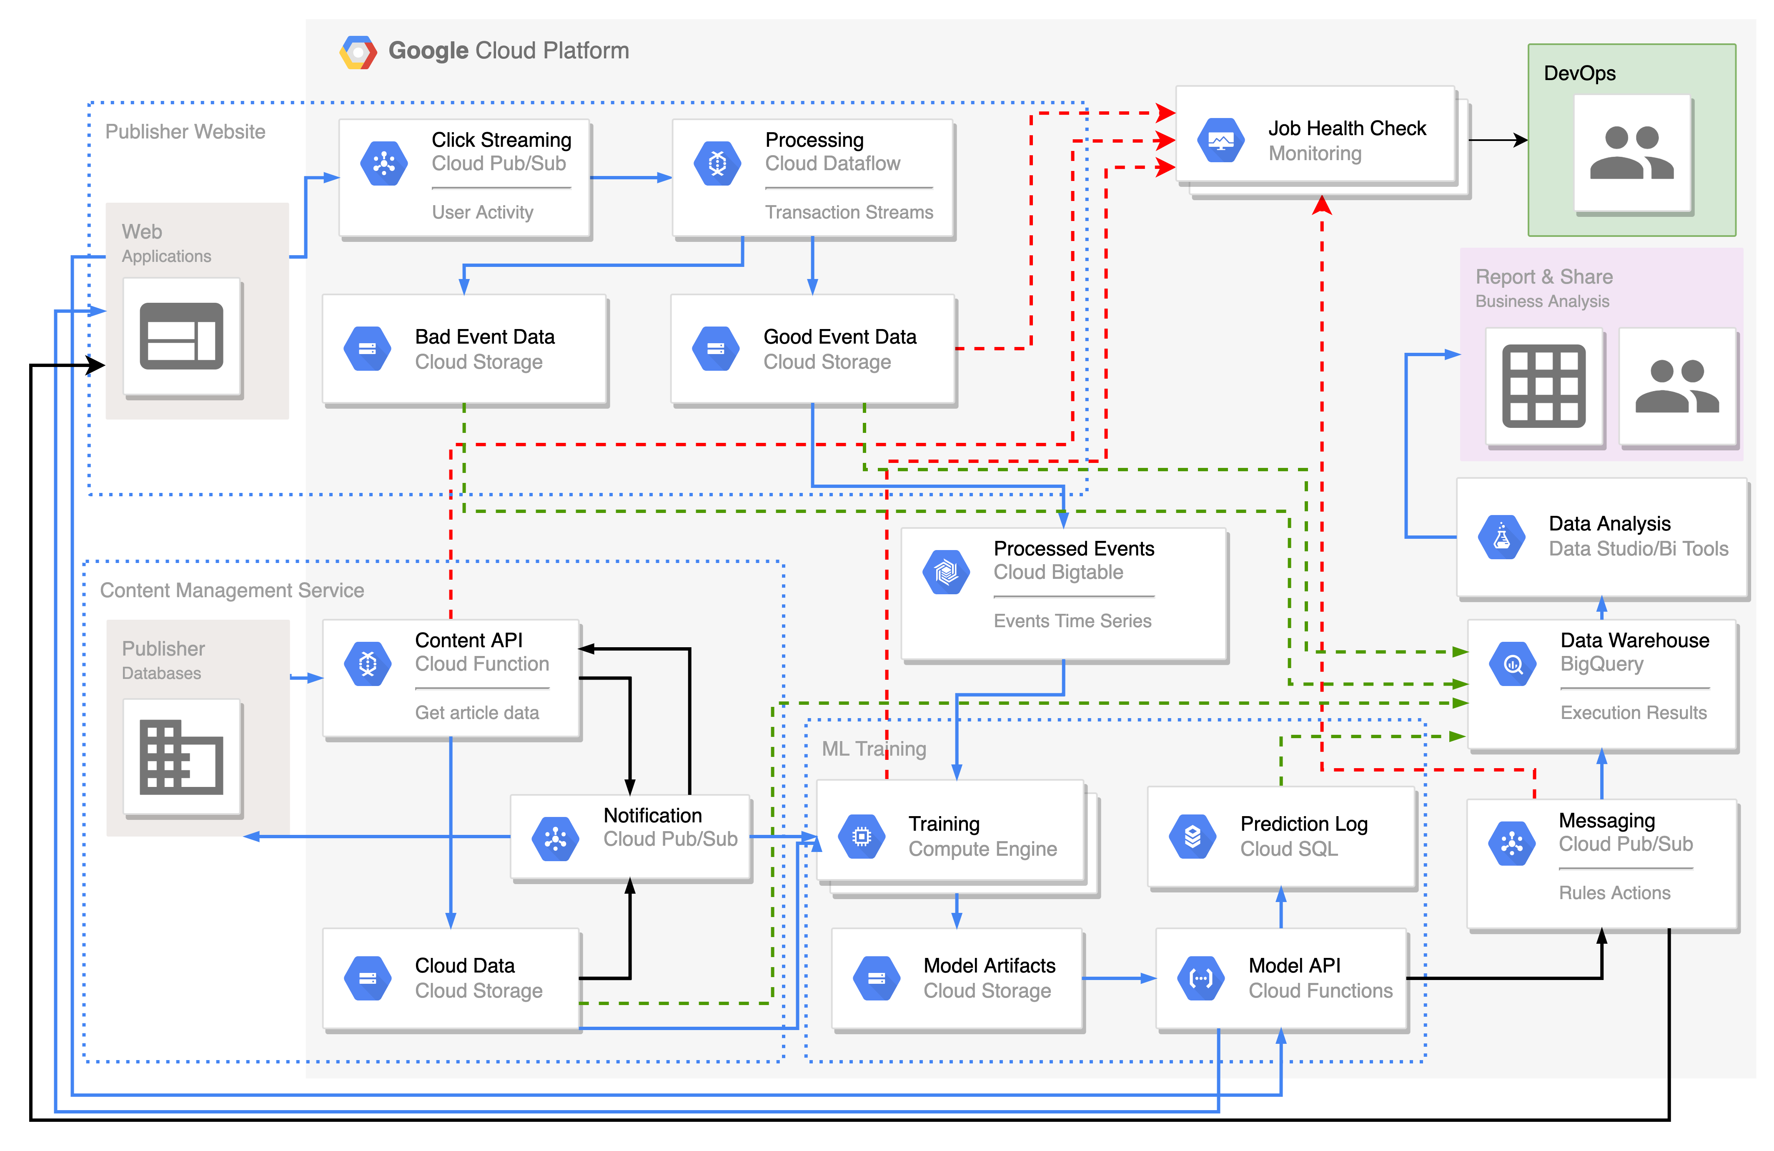
Solution Architecture Overview
The solution is implemented in GCP using:
Cloud Functions
Cloud Storage
BigQuery
Cloud SQL
Pub/sub scheduler

Slide 8
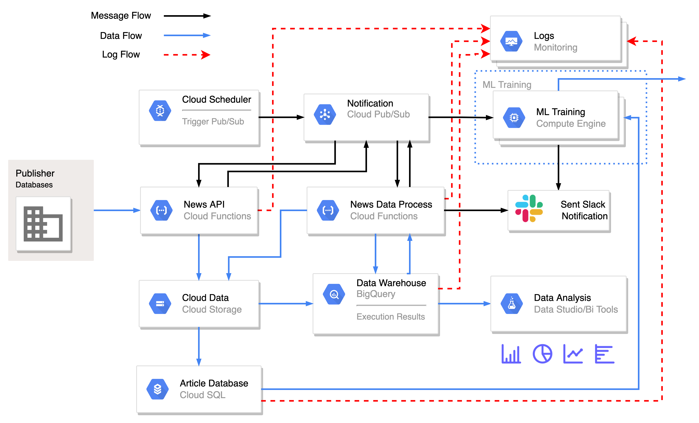
Content Management

Slide 9
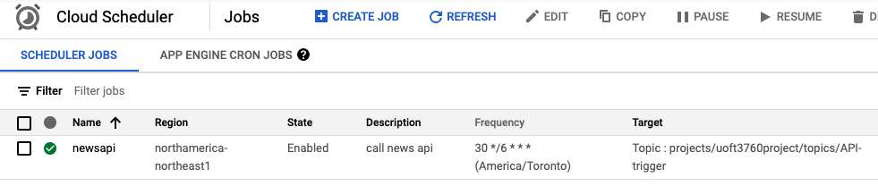
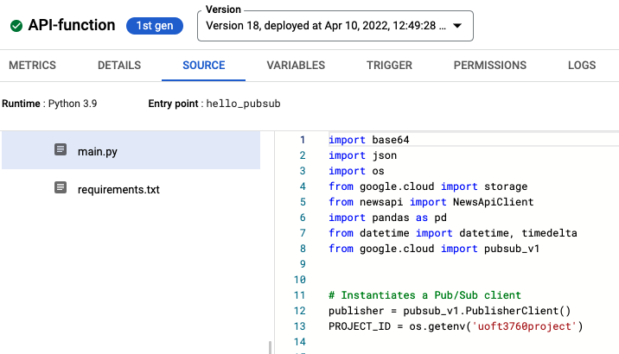
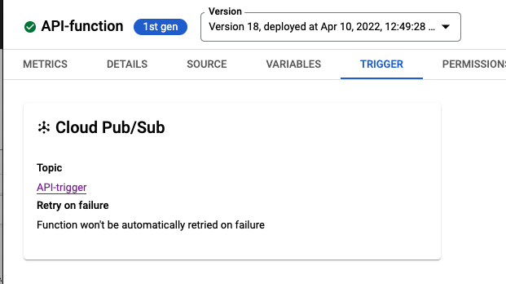
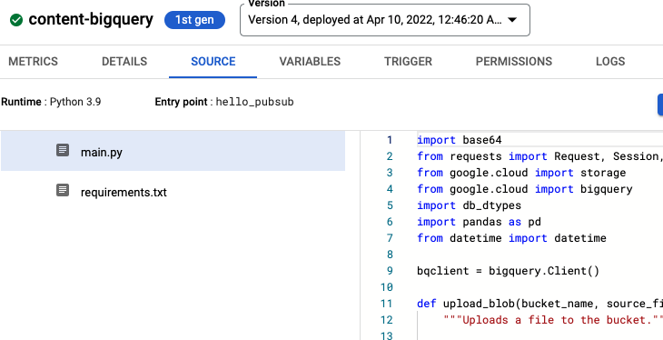
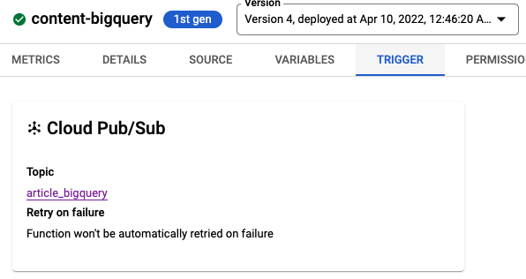
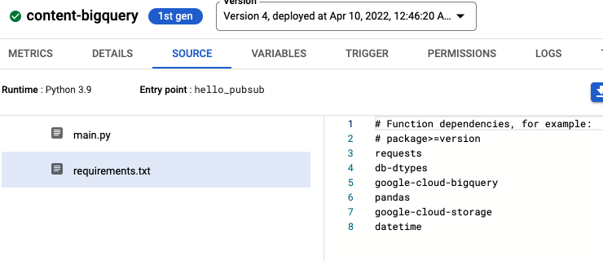
Implementation
Cloud Scheduler
Pub/sub #1
Cloud function #1 (News API)
Get News from Publisher API
Save csv files to Cloud Storage
Pub/sub #2
Cloud Function #2
Run BigQuery get data from Cloud Storage
Process Data
Save Processed Data to Cloud Storage
Update data to Cloud SQL
Pub/Sub #3
Train model

Slide 10
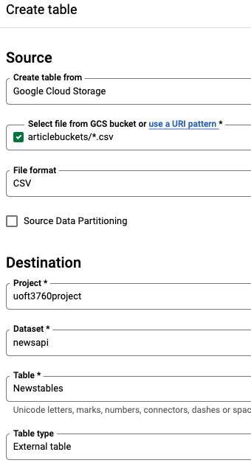
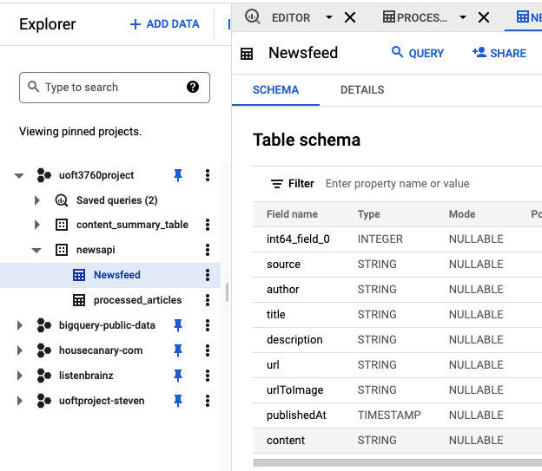
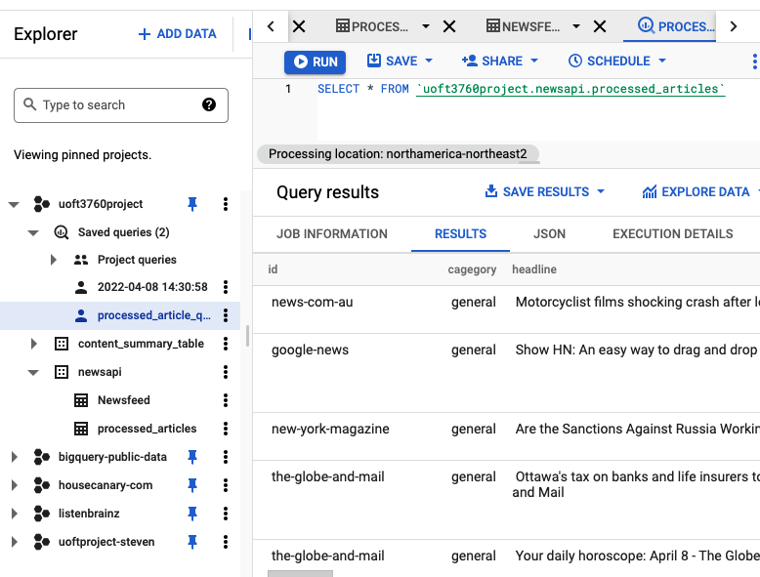
Implementation cont. (Bigquery)

Slide 11
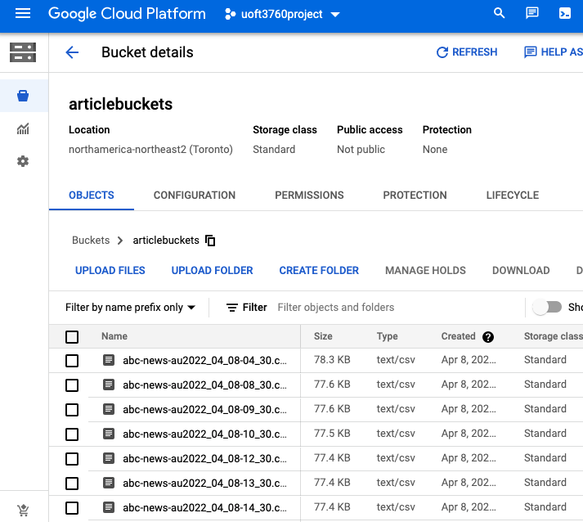
Implementation cont. (Cloud storage)

Slide 12
Word to vector model
We are using sklearn.feature_extraction.text.TfidfVectorizer and sklearn.metrics.pairwise_distances
TfidfVectorizer takes all the “words” from each article to create a matrix of term frequency
Pairwise distances is used to calculate the Euclidian distance between two matrices
The final model is weighted:
0.6x headline and short description
0.2x category
0.1x author
0.1x publish day

Slide 13
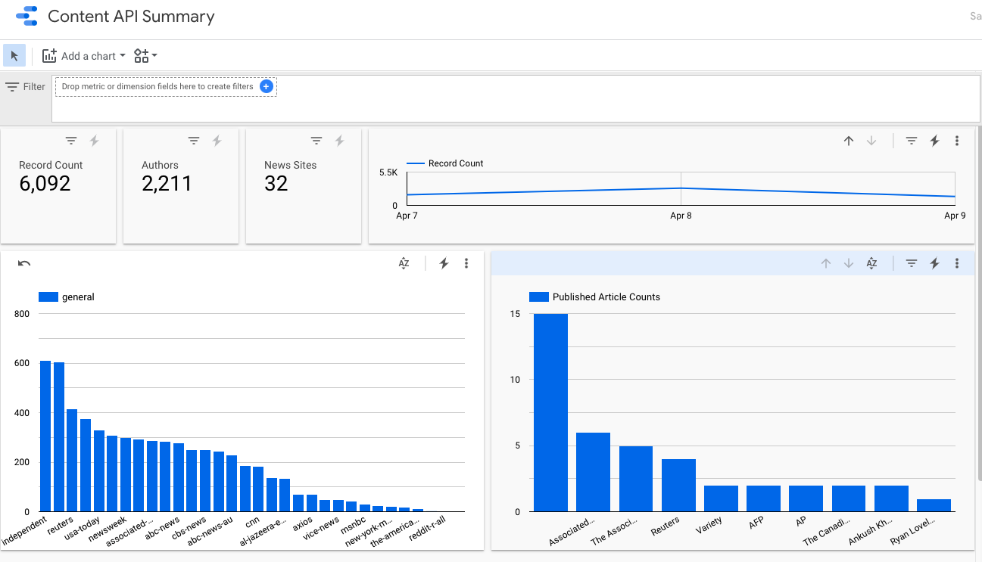
Data analysis

Slide 14
Thank you!
Any Questions?

